Slide 1

Agile VS the Waterfall Presentation
Daniel Gorelkin – CS250
Notes:
[No speaker notes required for this slide.]

Slide 2

Agile Roles
The Product Owner
The Product Owner is responsible for maximizing the value of the product and the work of the Development Team.
The Scrum Master
The Scrum Master is responsible for ensuring Scrum is understood, effective, and completed on time by maximizing Sprint’s value and outcome.
The Developers Team
The Development Team consists of professionals who do the work of delivering a releasable increment of completed product at the end of each Sprint.
Notes:
The Product Owner (PO)
The PO works as an interface between the client and the team. He / She translates the client’s/user needs into user stories and defines how the project will be done.
The PO is responsible for defining and constructing the product backlog.
The PO serves as a mitigator between the development team and the client.
The PO prioritizes features based on customer needs, business goals, and product value.
The PO ensures that the Product Backlog is visible, transparent, and straightforward to the team and presents what the Scrum Team will work on next Sprint.
The Scrum Master (SM)
The SM acts as a facilitator and coach for the Scrum team. He / She promotes a culture of continuous
improvement, ensuring that the team follows Scrum practices effectively.
The SM helps the Team understand the need for clear and concise Product Backlog items.
The SM facilitates daily Scrum events to ensure productivity and efficiency.
The SM coaches the Team in self-organization and cross-functionality.
The SM removes impediments to the Team’s progress.
The Developers Team
The team consists of cross-functional members, including developers, designers, testers, and more who actually build the product. They are responsible for delivering shippable increments at the end of each Sprint.
The team is self-organizing. They are able to turn Product Backlog into increments of releasable functional software.
The Teams are cross-functional, having all of the skills to create a functional product increment.
Each individual Team member may have specialized skills and areas of focus and can fulfill any developer role in the team. Yet, the accountability belongs to the Development Team as a whole.

Slide 3
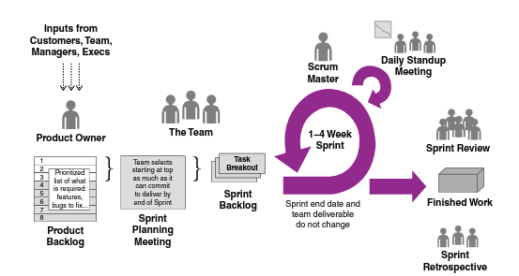
The Scrum framework. - Requirements Gathering - Product Backlog - Sprint Planning and Backlog - Daily Scrum - Sprint Review - Sprint Retrospective
Agile Phases
Notes:
- Requirements Gathering
The team works with stakeholders to gather high-level requirements and define a product vision. Later, detailed requirements for specific features are revised. These steps dictate the flow and the completeness of the project.
- Product Backlog
The product backlog is a queue of the work to be done organized in the form of small increments by its value and presented to the team in the form of user stories. This helps to describe the user requirement in very concise terms and briefly define what the user expects to get and what the acceptance criteria are.
- Sprint Planning and Backlog
The PO, SM, and the team will negotiate what stories will be completed during the sprint, define the tasks that will be needed to implement those stories, and plan how those stories and tasks will be allocated among the developers on the team. This phase creates a detailed plan on what and how should be accomplished during the Sprint while the Sprint backlog is being revised after each Sprint cycle.
- Daily Scrum
The Daily Scrum is a line-up meeting for everyone on the team to coordinate what’s going on, monitor progress, and identify any obstacles that may be inhibiting progress.
The importance of the meeting is to identify any issue that could cause delays, find ways for improvement, and update all team members about the progress of each player.
- Sprint Review
During the Sprint review, the team presents the completed work to the product owner for his/her final review and approval and provides a finished software for the client’s approval. This phase is important to get feedback from the client that the team is on the right track and it can move on to the next Sprint.
- Sprint Retrospective
The sprint retrospective is an opportunity for the whole team to review and discuss lessons learned at the end of each Sprint, to look back, and to reflect on what worked well and what should be improved in the next Sprint. This phase provides the opportunity for the whole team to improve and learn from their previous mistakes.

Slide 4
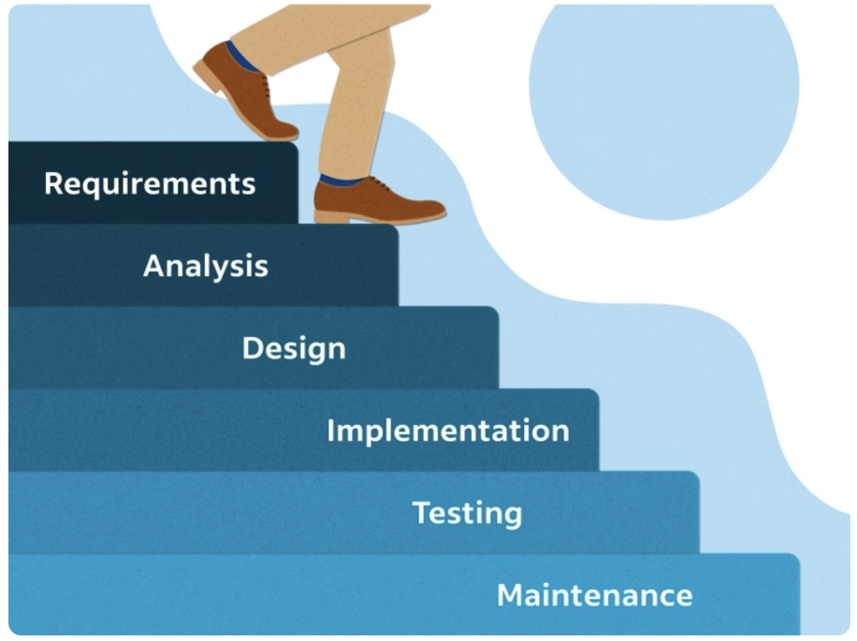
The Waterfall Model
Notes:
The Waterfall development approach significantly differs from the Agile methodology in its phases.
It divides the development into sequential phases where each following phase is entirety dependent on the preceding.
Requirements gathering and documentation phase happens exhaustively at the beginning of the project.
Dedicated design phase where all architectural, technical, and user interface details are planned.
Integration would occur only after all components are completed while each developer works in isolation.
Testing is conducted at once only after the entire development and implementation phase is complete.
Maintenance and modification requires going back to earlier phases, which can be time-consuming and costly.
Developing the SNHU Travel project with the Waterfall model could potentially lead the team to an irreversible failure. This is due to the disability to handle changes and modifications throughout the development process.
For example, After spending a significant amount of time, financial investment, development efforts, and human resources, a stakeholder’s request to shift the development from the plan will result in scrapping all the accomplished progress and literally returning to the starting point. Moreover, due to the disability to present and get feedback from the stakeholders amid the development phases and delivering a fully completed project that will not satisfy the client will lead to an even worse result.
However, that does not mean that the Waterfall model is useless. Rather, it should be implemented in projects with very high known certainty levels…

Slide 5
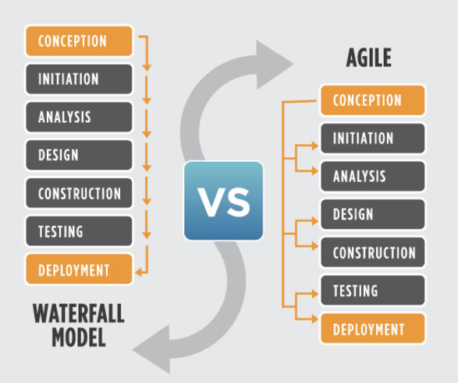
Agile VS the Waterfall Approach
Notes:
Factors to consider when choosing a waterfall or Agile approach.
Both Agile and Waterfall have their own pros and cons, and one approach can not work for all projects.
The Agile - The Scrum-Agile approach highly relies on the team skills and proficiency of the team members. It is the best fit for projects that require flexibility, frequent customer feedback, requirement change, and rapid adaptation, while the initial requirements contain high uncertainty. In projects with high predictability and very well-defined and fixed requirements, conducting the Agile ceremonies and investing time in meetings instead of rich documentation and development could be a burden and decrease the team’s performance, while communication and collaboration can become more complex with distributed teams.
The Waterfall - The Waterfall model works better for projects that have high predictability and very well-defined and fixed requirements that will not change throughout the SDLC, and the client requires concrete deadlines and costs to be delivered and handled upfront. Requirements updates during an advanced stage of the SDLC can lead the team to failure due to difficulty/disability in modifying the project after investing significant efforts and time in developing and documenting the requirements and leading the team to start the efforts from scratch.

Slide 6
References
References:
Agile Alliance. (2023, October 18). Agile Manifesto for Software Development | Agile Alliance. Agile Alliance |. https://www.agilealliance.org/agile101/the-agile-manifesto/
Charles G. Cobb. (2015). The Project Manager’s Guide to Mastering Agile : Principles and Practices for an Adaptive Approach. Wiley. https://search.ebscohost.com/login.aspx?direct=true&AuthType=ip,shib&db=nlebk&AN=937009&site=ehost-live
Sliger, M. (2012). Agile estimation techniques. Paper presented at PMI® Global Congress 2012—North America, Vancouver, British Columbia, Canada. Newtown Square, PA: Project Management Institute.
The Agile Modeling (AM) Method. (2023b, November 23). Agile Requirements Change Management. The Agile Modeling (AM) Method - Effective Strategies for Modeling and Documentation. https://agilemodeling.com/essays/changeManagement.htm#PrioritizingRequirements
Notes:
References:
Agile Alliance. (2023, October 18). Agile Manifesto for Software Development | Agile Alliance. Agile Alliance |. https://www.agilealliance.org/agile101/the-agile-manifesto/
Charles G. Cobb. (2015). The Project Manager’s Guide to Mastering Agile : Principles and Practices for an Adaptive Approach. Wiley. https://search.ebscohost.com/login.aspx?direct=true&AuthType=ip,shib&db=nlebk&AN=937009&site=ehost-live
Sliger, M. (2012). Agile estimation techniques. Paper presented at PMI® Global Congress 2012—North America, Vancouver, British Columbia, Canada. Newtown Square, PA: Project Management Institute.
The Agile Modeling (AM) Method. (2023b, November 23). Agile Requirements Change Management. The Agile Modeling (AM) Method - Effective Strategies for Modeling and Documentation. https://agilemodeling.com/essays/changeManagement.htm#PrioritizingRequirements

